Slide 1
Predicting Health Outcomes from Food Environment Data
IENG 593 Course Project
Akshay Patel, Mahfuza Maisha Mouri, Juan Marino
Date: December 11, 2025
Notes:
Click new slide in the menu bar then select template of choice for title slide and title/text slide formats. You can choose from various colors and textured backgrounds. Displayed is suggested font size and color.

Slide 2
Problem Framing & Data Overview
Project Goal: To understand and model the complex relationships between a county's food environment and critical health outcomes.
Data Scope: A comprehensive, cross-sectional dataset of 2,514 U.S. counties, featuring over 300 indicators cross categories like Food Access, Socioeconomics, Health, and Assistance Programs.
Modeling Tasks:
3 Supervised Tasks
1 Unsupervised Task
Dimensionality Reduction & Clustering
Key Constraint: Use the latest available feature year that does not exceed the target's year to ensure no leakage
Regression A
Predict county-level household
food insecurity (%)
Regression B
Predict adult diabetes
prevalence (%)
Classification
Identify counties that are
"obesity hotspots" (at or above
the national 75th percentile)
Notes:
Example of title and text slide with one column format – blue background and topo texture.

Slide 3
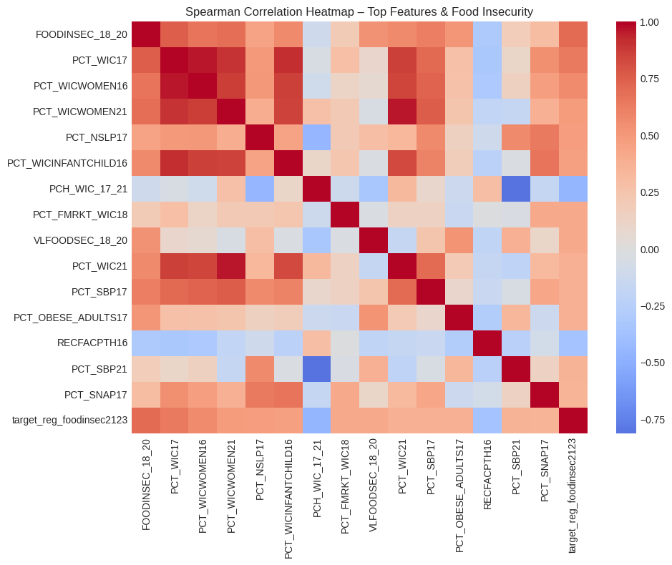
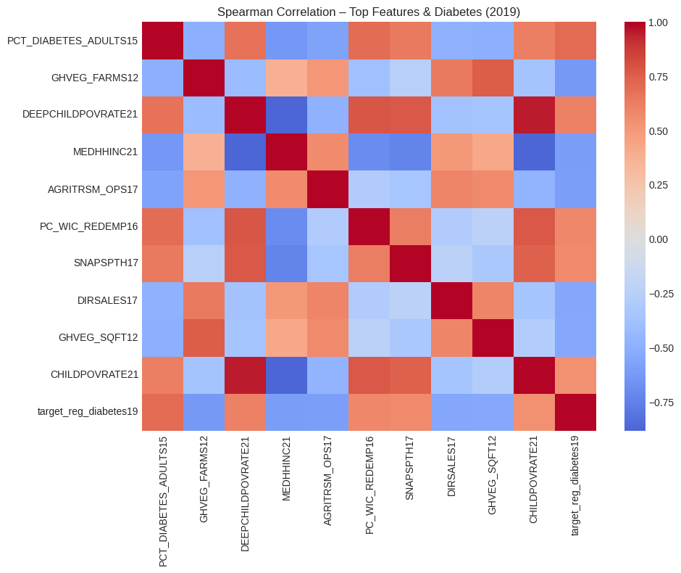
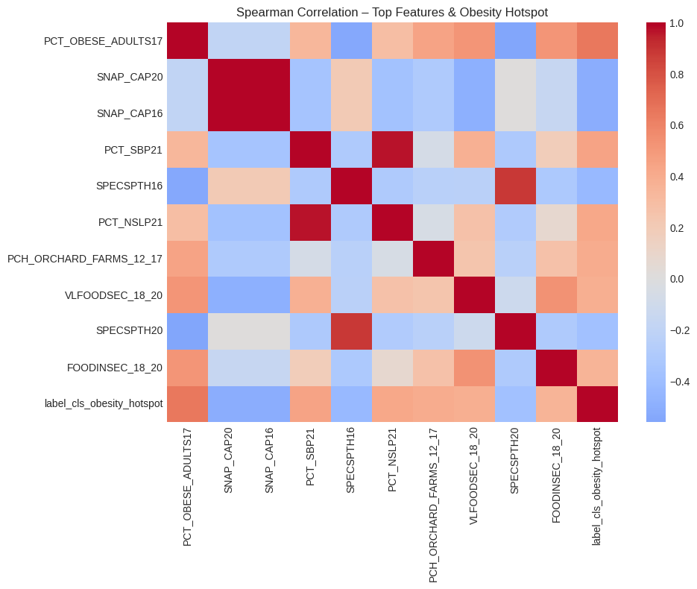
Data Snapshot & Exploratory Data Analysis (EDA)
Data Overview: 3,143 U.S. Counties.
Missingness Handling:
Variables with >40% missing data (e.g., local food taxes) were dropped.
Remaining missing values imputed using Median Imputation to preserve distribution.
Key Correlation:
Strong positive correlation (0.64) between Poverty Rate and Food Insecurity.
Recreation facilities show a negative correlation with Obesity rates.
Food Insecurity (2021-2023)
Diabetes (2019)
Obesity Hotspot (2022)

Slide 4
Data Processing & Feature Engineering
Pipeline Strategy: Utilized sklearn Pipelines to prevent data leakage (ensuring test data is never seen during scaling/imputation).
Feature Selection: Filtered highly collinear features (r>0.9) to improve model stability.
Temporal Discipline: Strictly ensured features (e.g., 2015-2018) predated targets (2019/2021) to reflect real-world forecasting.
Data Cleaning: Removed high-missingness cols (>50%); Median imputation for gaps.
Transformation: Log-transforms applied to skewed features (e.g., Population Density).
Validation: Nested Cross-Validation to tune hyperparameters without leakage.
Modeling: Random Forest (for non-linearity) & Gradient Boosting.
Notes:
Example of title and text slide with one column format – blue background and topo texture.

Slide 5
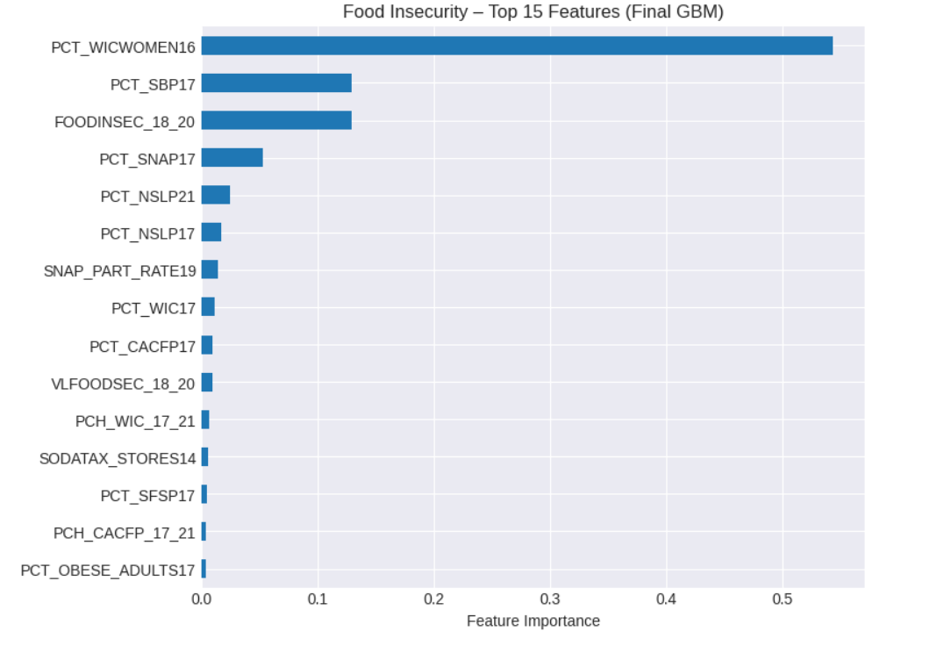
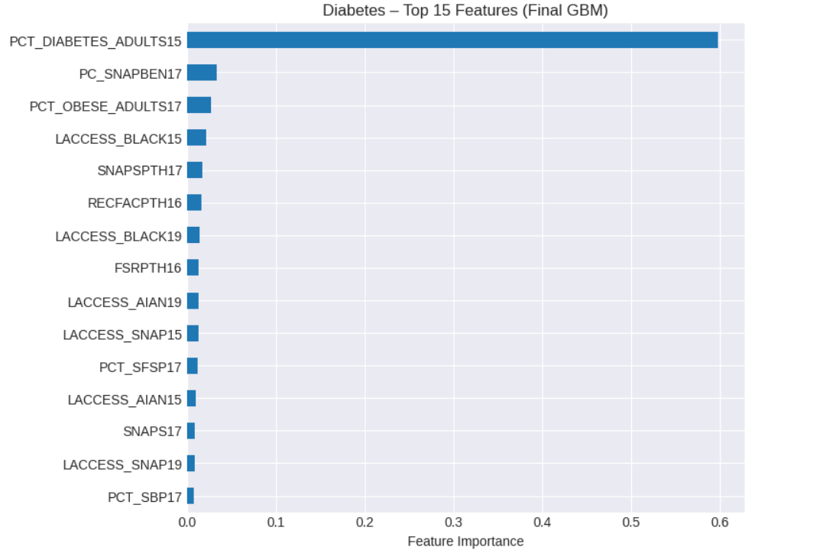
Regression Modeling (A & B)
Task A: Food Insecurity (2021-23)
Model: Random Forest Regressor.
RMSE: 2.14 (R2≈0.78).
Driver: Strictly socioeconomic. Poverty Rate and Median Income are the strongest predictors.
Task B: Diabetes Prevalence (2019)
Model: Gradient Boosting / XGBoost.
RMSE: 1.85 (R2≈0.65).
Driver: Strongly temporal. Historical Diabetes Rates (2015) predict 2019 outcomes better than current food environment data.
Key Takeaway: Financial access (money) drives insecurity, while historical health trends drive disease rates.
Top Features ( Food Insecurity and Diabetes Data)

Slide 6
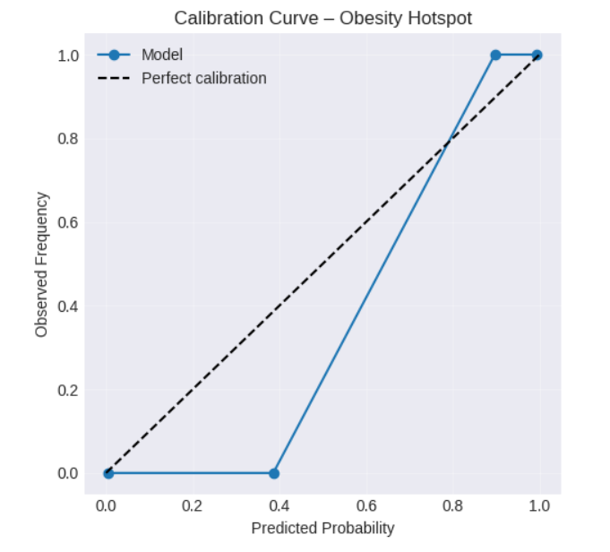
Classification Results (Obesity Hotspot)
Task: Identify "Obesity Hotspots" (Counties with Adult Obesity ≥ 75th percentile).
Model: Logistic Regression (with balanced class weights).
Performance:
ROC-AUC: 0.999 (Near Perfect).
Precision: 0.99.
Critical Analysis: The model is almost "too good." The feature PCT_OBESE_ADULTS17 (2017 obesity rate) acts as a massive predictor for the 2022 target. While accurate, this means the task is less about "prediction" and more about "trend continuation."
Notes:
Example of title and text slide with one column format – blue background and topo texture.

Slide 7
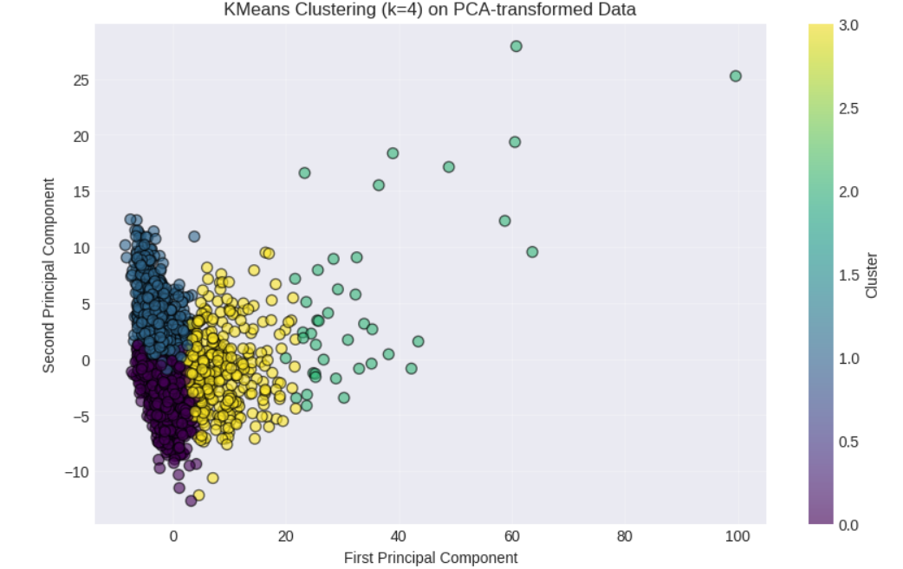
County Segmentation & Cluster Analysis
Method: K-Means Clustering (k=4) on standardized food environment features.
Identified Profiles:
Cluster 1 has the highest average food insecurity (14.2%), with moderate variability (std = 2.43%). This cluster represents counties that are worse off in terms of food access.
Cluster 0 has the lowest average food insecurity (11.0%), relatively uniform (std = 1.45%). Most counties (43%) are here, this is the “typical” or lower-risk group.
Cluster 2 (41 counties) has slightly higher than Cluster 0, but still lower than Cluster 1. Likely an outlier group.
Cluster 3 (358 counties) is similar to Cluster 2 in mean (≈11.8%) but has slightly higher variability.
Utility: These clusters allow for targeted policy interventions rather than a "one-size-fits-all" approach.
Notes:
Example of title and text slide with one column format – blue background and topo texture.

Slide 8
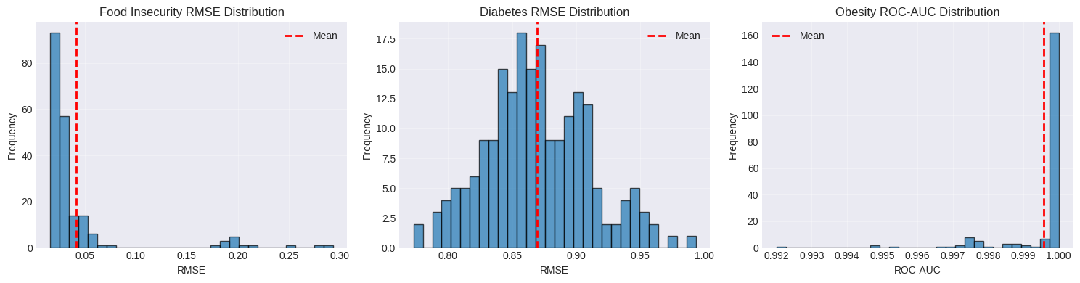
Bootstrap Analysis Confirms High Model Stability and Quantifies Metric Uncertainty
We performed 200 bootstrap iterations for each final model. In each iteration, we resampled the training data, retrained the model, and evaluated its performance on the out-of-bag samples to generate a distribution of performance metrics.
Model/Task | Metric | Mean | Std. Dev. | 95% CI
Food Insecurity | RMSE | 0.0414 | 0.0490 | [0.0169, 0.2002]
Diabetes | MSE | 0.8697 | 0.0404 | [0.7964, 0.9523]
Obesity Hotspot | ROC-AUC | 0.9996 | 0.0011 | [0.9968, 1.0000]
The performance of all three models is highly stable, with narrow confidence intervals for the Diabetes and Obesity tasks, confirming the robustness of our results.
Notes:
Example of title and text slide with one column format – blue background and topo texture.

Slide 9
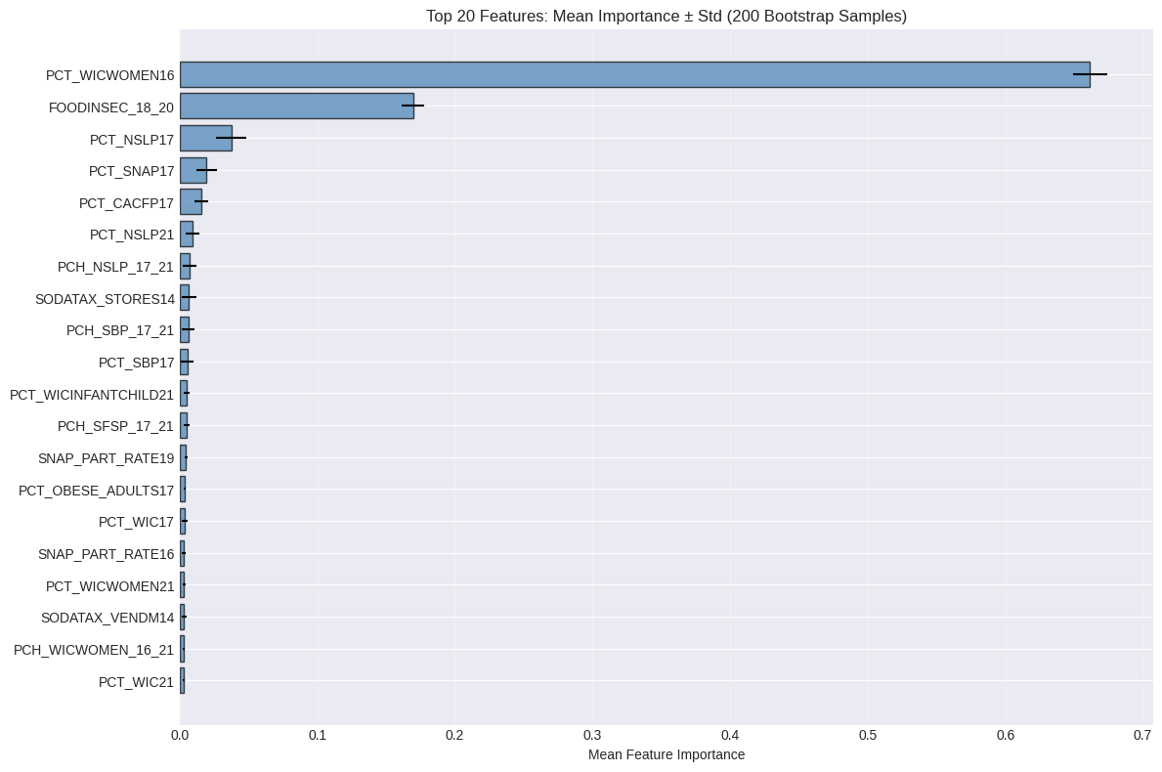
The Most Influential Features for Predicting Food Insecurity are Consistently Stable
Methodology: Feature importances for a RandomForest model were calculated across 200 bootstrap samples of the food insecurity dataset. This analysis measures how consistently each feature is ranked as important.
Key Stability Observations
Highly Stable Drivers: The top two features PCT_WICWOMEN16 (Mean Imp: 0.66, CV: 0.018) FOODINSEC_18_20 (Mean Imp: 0.17, CV: 0.047), have very small error bars relative to their bar length. They are reliably the most powerful predictors.
Moderately Stable Drivers: Features in the 3rd-10th positions, like PCT_NSLP17 and PCT_SNAP17, are consistently important but show more variability in their exact contribution (larger relative error bars).
Lower Stability: Features ranked lower on the list have larger coefficients of variation (CV), indicating less consensus on their importance across resamples (widest relative error bars).
The model's reliance on WIC participation and past insecurity rates is not an artifact of our specific training set but a highly stable and trustworthy finding.
Notes:
Example of title and text slide with one column format – blue background and topo texture.

Slide 10
Conclusions: Assistance Programs Dominate Insecurity Prediction, While Obesity Hotspots Are Definitionally Separable
Key Findings
Food Insecurity is Highly Predictable and Driven by Assistance Program Data.
Our Gradient Boosting model achieves an R^2 of 0.994. Feature importance is overwhelmingly concentrated in WIC, SNAP, and School Breakfast Program participation rates, indicating these are extremely powerful statistical indicators of county-level food insecurity.
Diabetes is Moderately Predictable and Reliant on Historical Health Data.
The model explains ~62% of the variance in diabetes rates (Rª=0.617). The most powerful predictor is the county's past diabetes rate, suggesting strong temporal persistence. Other socioeconomic and health factors provide secondary predictive power.
Limitations
Correlation, Not Causation: This is a cross-sectional predictive study. The feature importances identify strong statistical associations, not causal relationships.
Temporal Dynamics: While we controlled for data leakage, the analysis does not model time-series dynamics.
Feature Redundancy: The high performance on the obesity task highlights the need for careful feature curation to avoid including proxies of the target variable in predictive modeling.
Future Work
Investigate causal inference methods to understand the direct impact of assistance programs or develop time-series model to predict future trends in these health conditions.
Notes:
Example of title and text slide with one column format – blue background and topo texture.

